Slide 1


Week- 13 CAMS Project Management – a Balancing Act; and Prioritization using MoSCoW Dr. Bhuvan UNHELKAR IT Faculty, College Of Business; Office: C225; bunhelkar@sar.usf.edu; 941-359-4654

Slide 2

Agenda
CAMS Project Management
Based on Chapter 8 (Pages 269 onward – 293)
EXCEPT (Figure 8.4, 8.8 and Table 8.2 – as they are out of scope of this discussion)
"Agile job aids" (Selected Agile Practices).
Study of Agile Practice : Prioritization MoSCoW
Summary & Consolidation

Slide 3

Sub-Module CAMS – Agile Management
A Balancing Act
(Based on Chapter 8 of Art of Agile Practice)
© MethodScience; Material Designed and Presented by Dr. B. Unhelkar; drawn from The Art of Agile Practice

Slide 4
Figure 8.1: Combining Planned and Agile Factors in CAMS-based projects
Planned Agile
CAMS
Value
Share
Uncertain
Subjective
Team
Situational
Task
Partition
Plan
Objective
Role
Standardized
Time - Budget
Function - Quality
Trust – Simplicity
Honesty - Courage
Management Leadership

Slide 5
Figure 8.2: Factors Influencing CAMS in Projects
Activities
(Tasks)
Practices
(Agile)
Project
Type & Size
Budgets
Resources
Maturity of
Process
Tool Support Required
Previous
Experience
CAMS
In
Projects
Roles
(People)
Deliverables
(Document)

Slide 6
Figure 8.3: Development a Project-level Instance of CAMS Instance
Analyze
Design
Code
Test
Waterfall Lifecycle
Analyze
Design
Code
Test
Analyze
Design
Code
Test
Iteration-1
Iteration-2
Iteration-3 ….
Practice-1
Standup
Practice-2
Pair Programming
Practice-3
Workshopping?
Agile
Practice-1
Practice-2…
CAMS Repository
Analyze
Design
Code
Test

Slide 7
Figure 8.5: Real Life Projects made up of Multiple Layers of Areas of Work
Business Needs
Impl. Project Initiation
Conceptual Requirements
Gap Analysis
Definition
Implementation
Testing
Deployment
Training
Generic
Project
Overview
Agile Manifesto & Values
Client Business
Needs
Exploration
Current Business
Position
Business Analysis
Core Business Needs
As-Is Business Process
Business
Analysis
Models;
Project Plans
To-Be Business Process
Implementation Project Charter, Plan
Business
Requirements
Functional
Models
Project Management
Solution Design (Initial)
Data – Functional
Gap
Data Gap Analysis -
Data Conversion
Data Configuration
Implement
Project
Define Gap
Plan
Implement
Test
Deploy
Agile
Values & Practices;
Change
Management
Agile Principles & Practices
Change Management & Control
Training
Support & Training
Maintenance

Slide 8
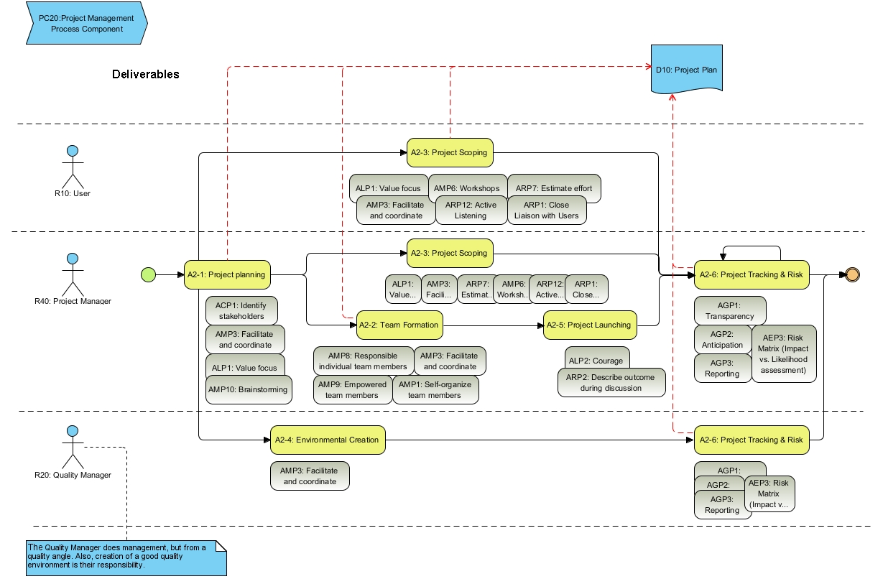
Figure 8.6: Project Management Process-Map in CAMS

Slide 9
Figure 8.7: Scoping a Programme of Work
Business NEEDS Resulting in Programme of Work
Multiple Projects
(Programme of Work)
Scope of a Project
Prioritization Based on RISKS
Time
Cost
Quality
Function
Other Areas of Work in an Organization – Not affected but need to be Aware of in a Holistic Transformation

Slide 10
Figure 8.9: Priorities and Iterations on Agile Project Charts
TO DO..
D O I N G …
D O N E..
Iteration - 1
S
M
M
Story-1
Story-8
Story-5
M
M
M
Story-2
Story-2
Story-3
C
Story-6
Iteration - 2
S
Story-3
S
C
Story-2
Iteration - 3
Story-7
W
M
Story-4
Story-7

Slide 11
Figure 8.10: Document Flow in CAMS
2
1
10 – Business Need
Statement
(Problem Statement)
25 - Project Charter
20 – Business
Transformation
Programme Plan
30 - Project Plan
15 – Post Project
Reviews (Metrics;
Patterns);
3
35 - Business Needs
Exploration
50 - Non-Functional
Requirements
40 - Functional
Requirements
4
60 – Development
65 - Acceptance
Test Plan
55 - Solution
Design
70 – Training Plan
Notes:
These are the Deliverables (primarily Documents) resulting from T2IP. This figure shows a typical flow of the documents – although you may occasionally want to change this flow. Having this basic flow in mind as your work through T2IP with a client is invaluable in visualizing where your work sits within the overall solution being provided to the client.
Each Document has a TEMPLATE – this is a standardized T2IP template; you may want to start your work with the help of this Template. Once again, depending on the Client and their needs and the type of project you are involved with, the template/s may have to be modified to suit the purpose.

Slide 12
Sub-Module Agile Job Aid for Prioritization
MoSCoW
© MethodScience; Material Designed and Presented by Dr. B. Unhelkar

Slide 13

Prioritization – MoSCoW (from http://www.allaboutagile.com/ prioritization-using-moscow/)
MoSCoW : Must have; Should have, Could have, and Won’t have (but Would like in future)
Must Haves‘ are features that must be included before the product can be launched.
‘Should Haves‘ are features that are not critical to launch, but are considered to be important and of a high value to the user.
‘Could Haves‘ are features that are nice to have and could potentially be included without incurring too much effort or cost.
‘Won’t Haves‘ are features that have been requested but are explicitly excluded from scope for the planned duration, and may be included in a future phase of development.
Notes:
The MoSCoW approach to prioritization originated from the DSDM methodology (Dynamic Software Development Method), which was possibly the first agile methodology (?) – even before we knew iterative development as ‘agile’.
by Kelly Waters, 12 January 2009 | Agile Planning
Must Haves‘or Minimum Usable Subset are features that must be included before the product can be launched.
‘Should Haves‘ are features that are not critical to launch, but are considered to be important and of a high value to the user.
‘Could Haves‘ are features that are nice to have and could potentially be included without incurring too much effort or cost. These will be the first features to be removed from scope if the project’s timescales are later at risk.
‘Won’t Haves‘ are features that have been reqeusted but are explicitly excluded from scope for the planned duration, and may be included in a future phase of development.

Slide 14
Conclusions & Future Directions
We discussed…??
Do you see what we see?

Slide 15


Slide 16
Sub-Module Agile Teams
Cross-Functional; Co-Located;
© MethodScience; Material drawn from The Art of Agile Practice (B. Unhelkar)

